Slide 1
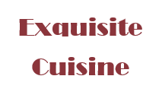
Amsterdam best Restaurant location

Slide 2
SG Consult I/O
Our small company is addressing the request from IFDR group (International Flying Dutch Restaurants) to perform a quick assessment for a new Restaurant location in Amsterdam

Slide 3
PROBLEM
Identify the optimal location in Amsterdam for a new High-Quality International Cuisine Restaurant planned to be developed in Amsterdam by IFDR

Slide 4
SOLUTION
We will use information from open public data available from Wikipedia on Amsterdam and its Boroughs, Open-Data portal of the city, and European Data Portal.
We use Python libraries to clean, filter, visualize, analyze and cluster the information.
We will perform K-Means clustering on the main data set and visualize information using Folium library

Slide 5
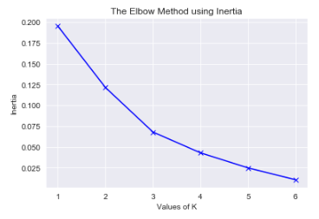
End-to-End Process
Data acquisition
Data Processing and Visualization
Clustering / mapping
Acquiring and aggregating data from open sources.
Amsterdam boroughs
Venue type and locations (Foursquare API)
Boroughs segmentation
Geolocation data
Demographics
Check for missing data, filter unnecessary data (Fast-Food, Snack-Bars, etc.)
Summary of Restaurants types per Borough.
Visualize relevant graphs
Data processing for clustering: one-hot encoding
Identify optimal K [3] cluster number
Perform K-Means clustering and add cluster labels to main table.
Use Folium to display the map of Amsterdam, clusters and restaurants

Slide 6
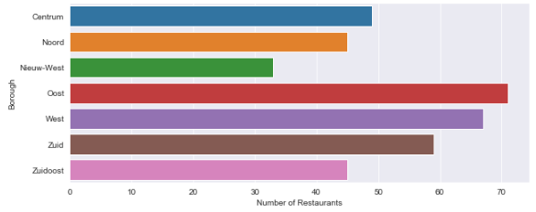
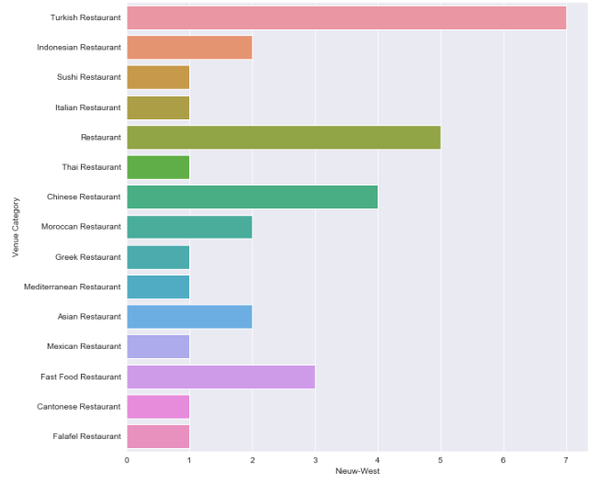
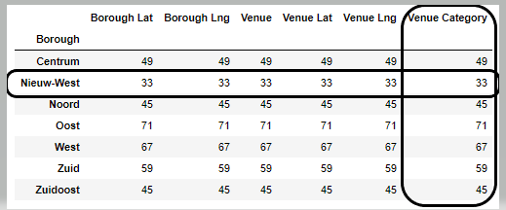
Visuals of relevant information
Restaurants per Borough
Nieuw-West Borough

Slide 7
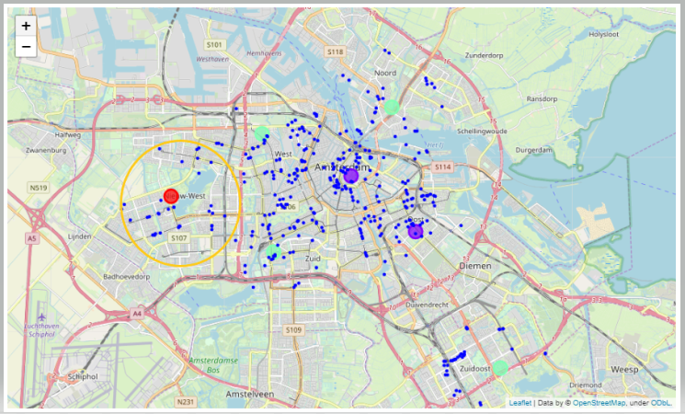
Amsterdam Map with clusters and Restaurants

Slide 8
Recommendation
Nieuw-West
Oost
Recommended Location
Alternative Location
Amsterdam Nieuw-West Borough with category type Restaurant mean of 15% and has a population of 151.677
Amsterdam Oost Borough with category type Restaurant mean 21% and has a population of 135.767

Slide 9
THANK YOU!
Sorin Gatea
Email:
sgatea@gmail.com

